Slide 1

Department of Computer Science and Engineering CSB4243 – DESIGN PROJECT 1 TABLE TENNIS USING HAND GESTURE Review-2
Dani N 21113004
Dharshan R E 21113049
SUPERVISORS
Dr.R.Krishnaveni, Professor
Dr.S.Sathyalakshmi, Professor

Slide 2
Agenda for Review2
Introduction
Goals and Motivation
Literature review/Existing Systems
Problem Definition
Objective
Proposed System/Work
System Requirement
Architecture Diagram
Module List
Modular Description
Implementation
Screenshots
Contribution of Team members
References

Slide 3
Introduction
We extend a warm welcome to our design project centered around Table Tennis using Hand Gesture. Our foremost goal is to fabricate a captivating and pulsating game by exploiting the potential of manual gesture identification technology. Our software utilizes webcam feeds, monitoring user's hands in real-time which steers rackets on-screen via their gestures; the ultimate aim being that users stop balls from passing through them unimpeded. OpenCV library has been implemented for image processing while cvzone serves as our tracking platform - ultimately this amalgamation leads us closer towards an immersive gaming experience with depth unlike any other.

Slide 4
Goals and Motivation
Goals:
To revolutionize the gaming experience by integrating hand gesture recognition technology into a Table Tennis game.
The ultimate goal of this project is to showcase the capabilities of hand gesture recognition technology in the field of gaming and its potential to create new and exciting gaming experiences.
And to provide an immersive gaming experience for the users.
Motivation:
The inspiration behind this project is the increasing interest in hand gesture recognition technology and its potential to bring a new level of interactivity to the gaming industry.
The project's aspiration is to provide a fun and unique way for users to interact with the game by using their hand movements, making the game more intuitive and engaging.

Slide 5
Literature review/Existing Systems
S.No | Title of the paper/System | Authors | Publication (Name of the Journal/Conference proceedings with Year) | Algorithm/Methodology adopted | Limitations
1. | Machine Learning With The Pong Game | Doina ,Logofătu | 21st International Conference on Computational Science and Applications(ICCSA),2021 | Q-learning is reinforcement learning algorithm where an agent learns to make decisions. Algorithm:Q-Learning | Accuracy:44.6% The Q-values requires more data
2. | Machine Vision-Based Ping Pong Ball Rotation Trajectory | Yilei, Wang & Ling, Wang | Journal of Computational Intelligence and Neuroscience,2022 | CNN also known as convnets used for image processing and object detection Convolutional neural network(CNN) | Accuracy:40.6% clarity of the captured video is not high enough, and the noise is high enough to make it indistinguishable

Slide 6
Literature review/Existing Systems
S.No | Title of the paper/System | Authors | Publication (Name of the Journal/Conference proceedings with Year) | Algorithm/Methodology adopted | Limitations
3. | Pong Game using AI | Akash ,R., Ruchika ,P .,& Ashish ,P.K | International Journal of Scientific and Research Publications,2022 | Q-learning is reinforcement learning algorithm where an agent learns to make decisions. The algorithm takes on both paddles using ai or bot Algorithm:Q-Learning | Lack of adaptability in different environment Accuracy:64.7 %
4. | Design of Game Pong using VHDL | Sudhanshu M.M., Nakul.N., | International Journal of Engineering Research & Technology (IJERT),2022 | Control the paddles is done without clicking repeatedly Algorithm:State Machine Algorithm | It will work only in the platform of windows Accuracy-50.4

Slide 7
Literature review/Existing Systems
S.No | Title of the paper/System | Authors | Publication (Name of the Journal/Conference proceedings with Year) | Algorithm/Methodology adopted | Limitations
5. | FGPA Implementation of Pong Game | Shith,T.H., Huang, Y.T., Tsai, J.T., | Federated Conference on Computer Science and Information Systems, 2022 | Difficulty modes are available like easy, medium and hard Algorithm:Finite State Machine | Connected only via VGA cable monitor Limited resources such as on-chip, memory, power consumption Accuracy:50.2%

Slide 8
Problem Definition
Lack of natural and intuitive control for this player
Difficulty in executing precise shots, such as spins and serves.
Limitations in replicating the physical movements of a real table
tennis player.
Inaccurate representation of player’s intent and skill level.
Decreased player engagement and enjoyment
Potential hindrance to the growth and development of the game
Lack of access to coaching and guidance for learning table tennis
Difficulty in finding a coach or someone experienced to play with
The need for software that can perform the job of a coach and provide recommendations for improvement

Slide 9
Objective
Controls the bats on the screen using hand gesture in multiplayer
Hit the ball back using computer-controlled AI bat in one side
Compete against the computer AI to achieve the highest score.
Aim to score points by strategically hitting the ball past the computer’s bat and onto the other side of the screen.
Direction of the ball depends on our hand movement

Slide 10
Proposed System/Work
In this project, we are going to create a Table Tennis game.
Detect and track hand movements using a camera or sensor.
Convert the hand gesture into specific commands for the game(e.g., move paddles racket up or down).
Transmit the commands to the game engine.
Update the game state based on the commands received.
Continuously monitor hand gesture and update the game accordingly.
Display the updated game state on the screen.
The system would involve machine learning techniques to recognize different hand gesture and map them to specific commands for the game. The system would also require a robust camera or sensor to accurately track hand movements in real-time.

Slide 11
SYSTEM REQUIREMENTS
1.OPERATING SYSTEMS:
Windows
Mac
2.SOFTWARE
Python
3.HARDWARE:
USB webcam

Slide 12
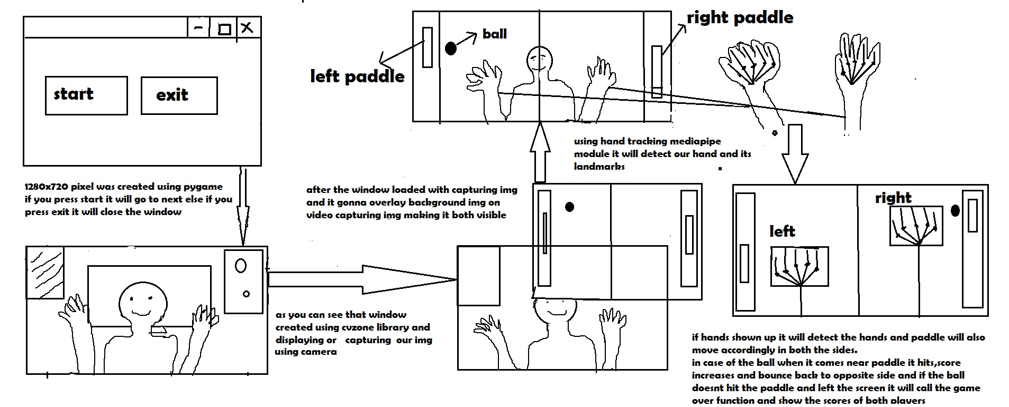
ARCHITECHTURE DIAGRAM

Slide 13
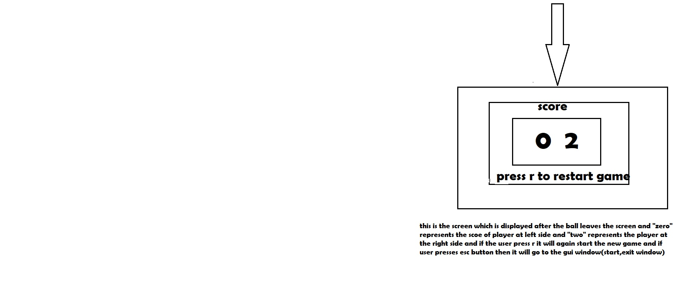

Slide 14
Module List
GUI
GUI Imports
Pygame Programs
Image Processing
Hand Tracking

Slide 15
Modular Description
GUI
GUI in simple terms is an interface for creating video games, Handles graphics, sound, user input, networking, API, and easy to learn
GUI Imports
GUI imports are used for importing the images, and audio files, and it is processed to make the interface more colorful.
Pygame Programs
It provides constants and events, including key and mouse events, video modes, and color values.
Image Processing
This is a computer vision library that provides tools for image and video processing and it is used to capture video from the camera and overlay images onto the video feed.
Hand Tracking
The hand tracking module is a third-party library built on top of OpenCV and Mediapipe that provides tools for hand detection and tracking in real-time video feeds.

Slide 16
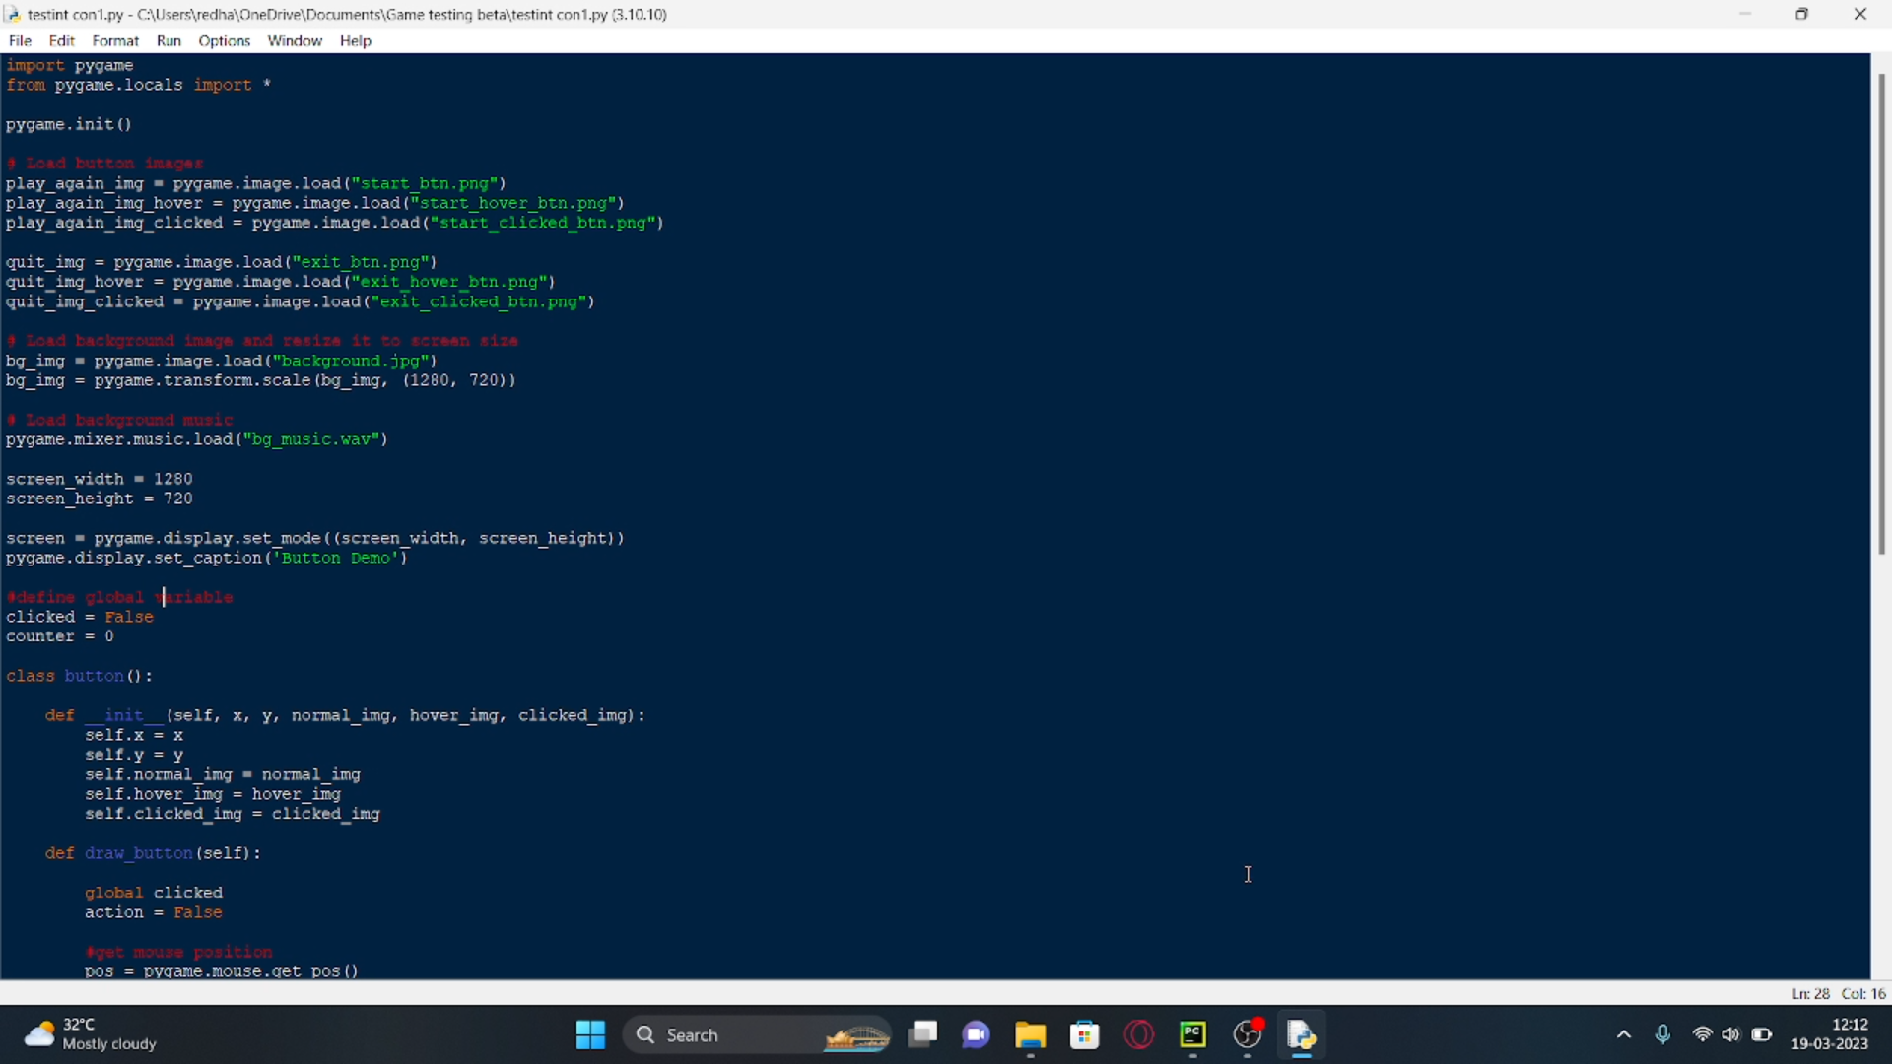
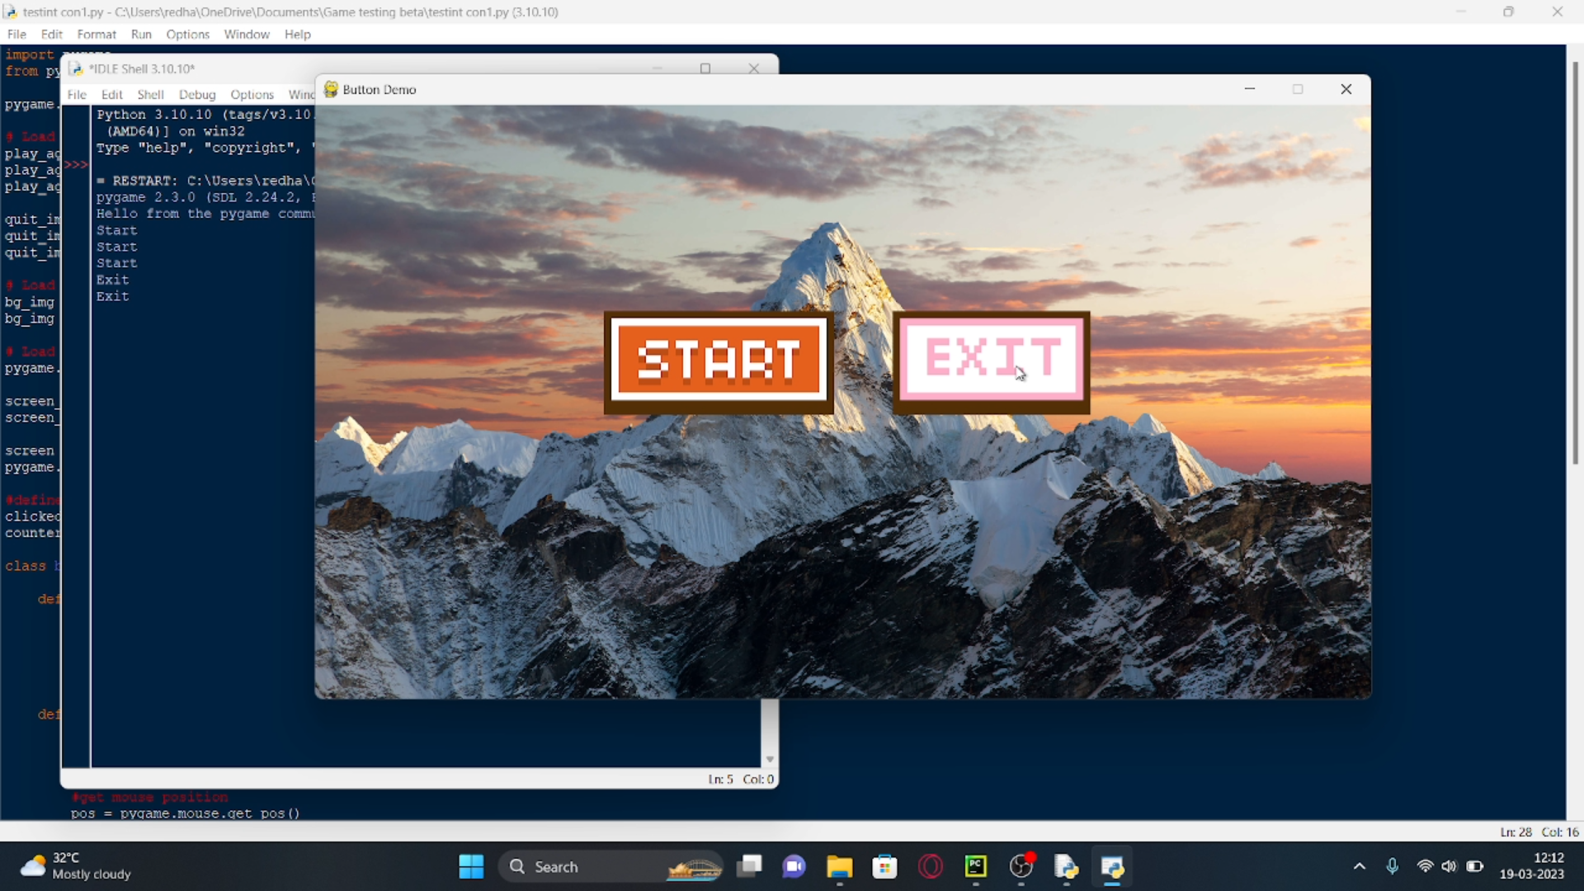
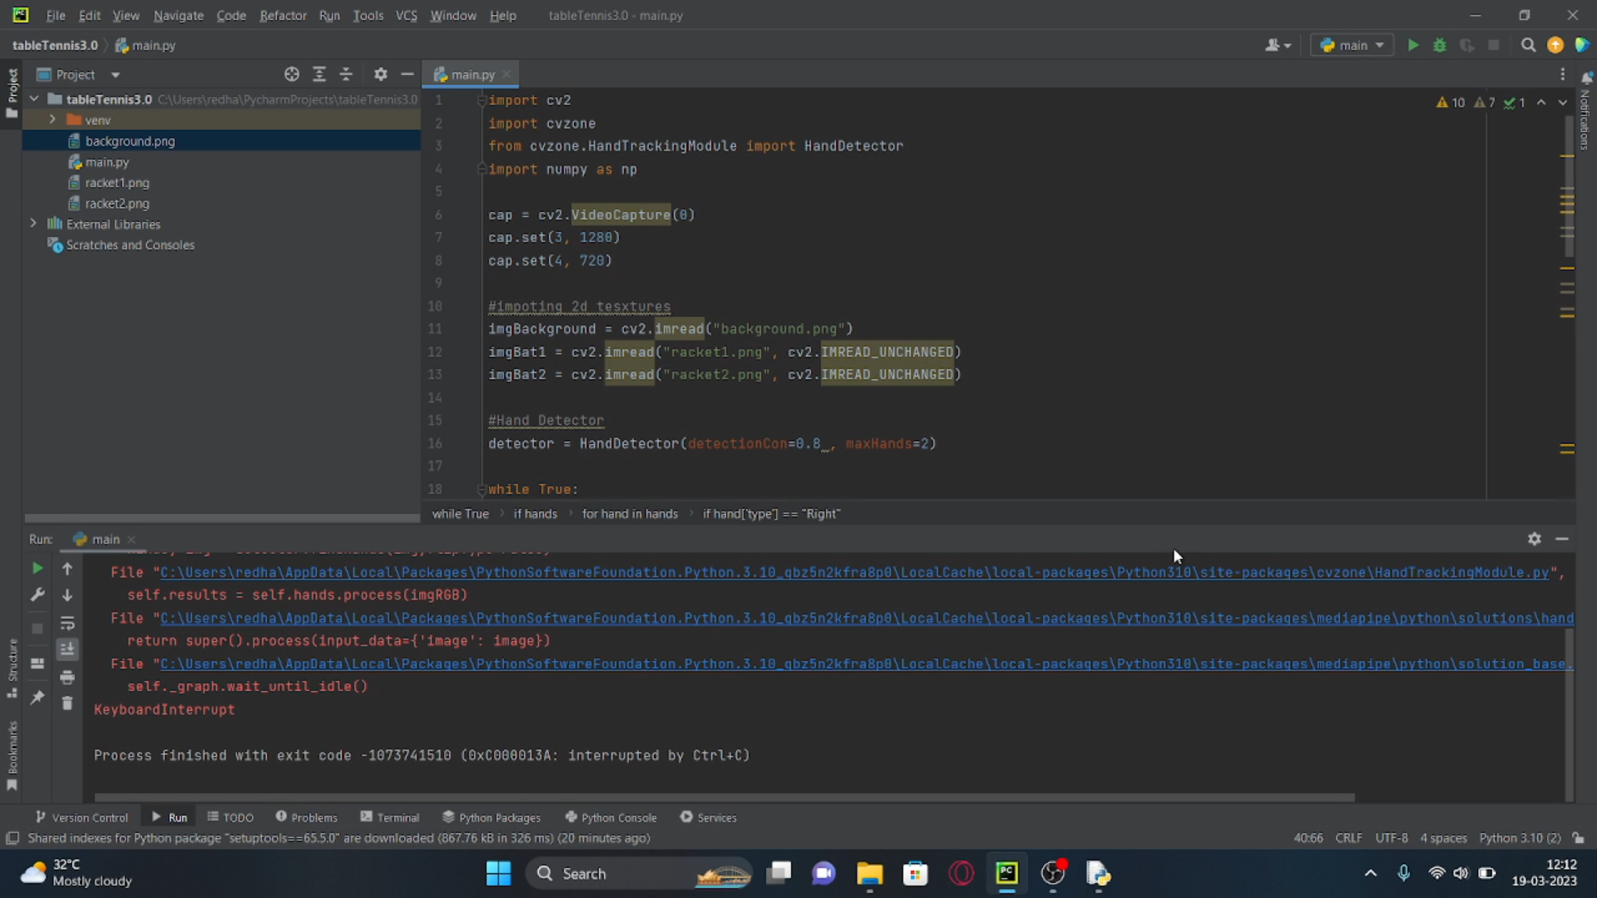
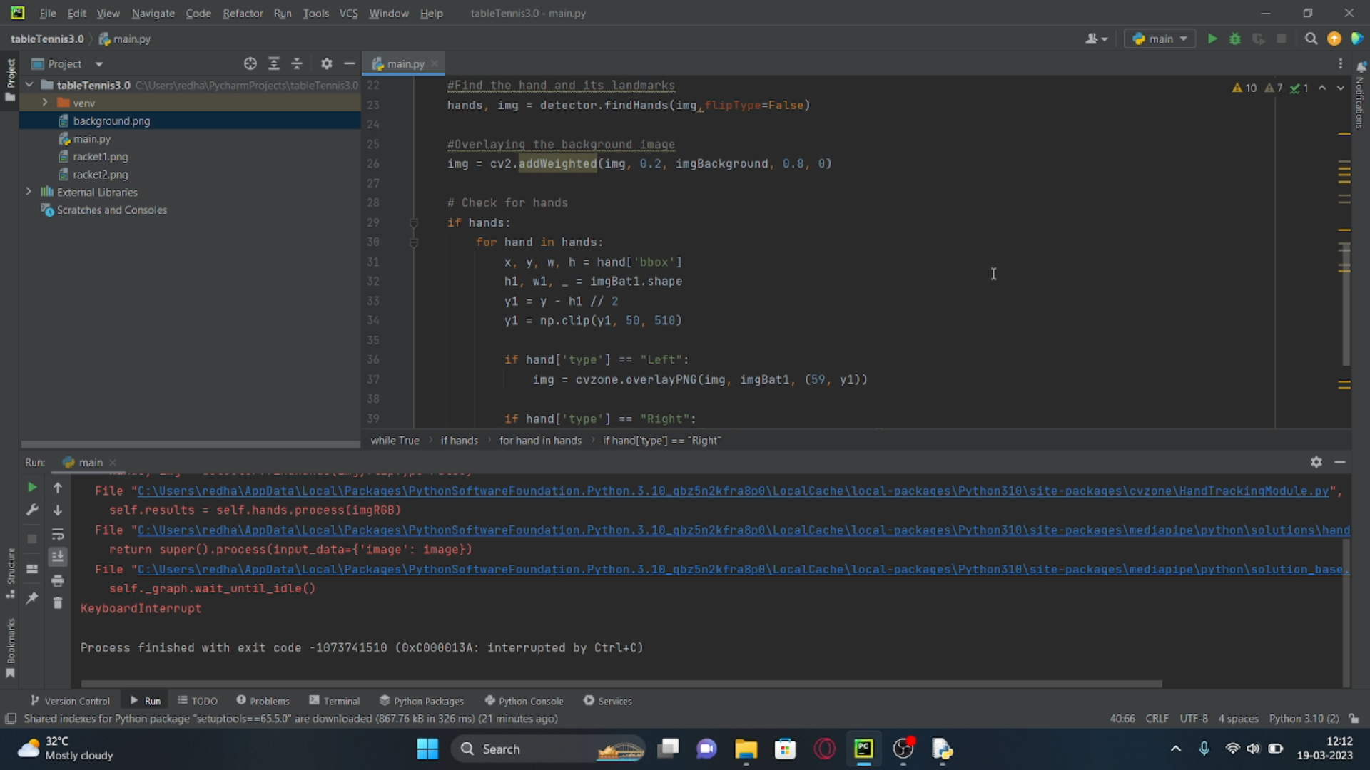
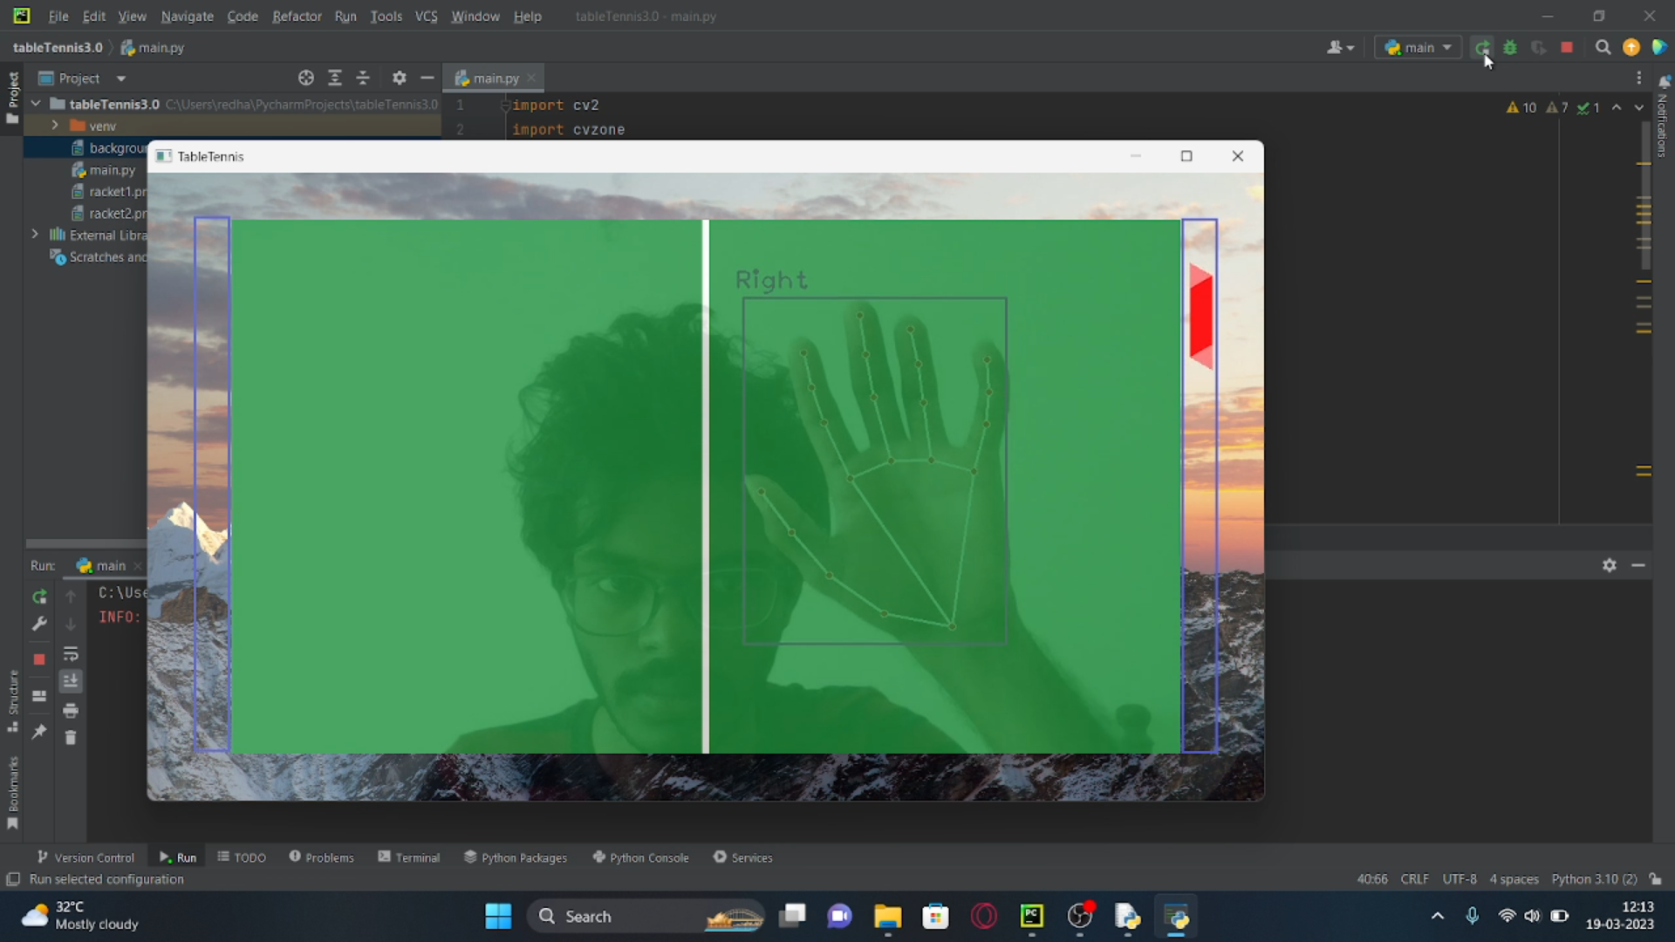
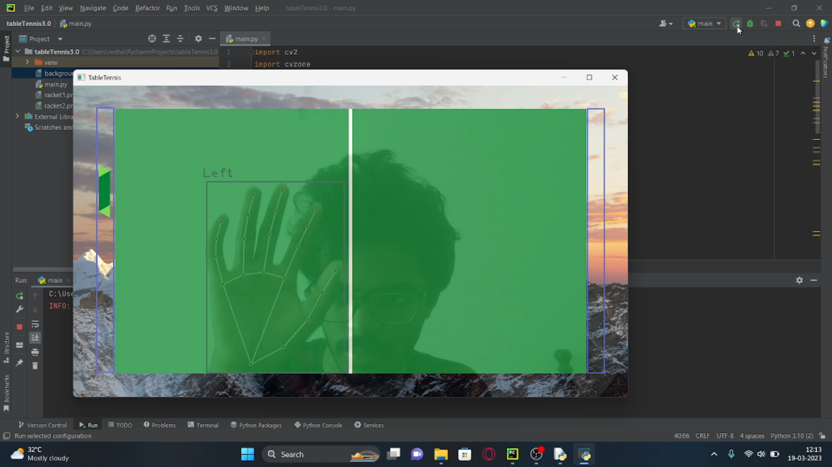
Screenshots

Slide 17
Contribution of Team members
Dani N(21113004)
Gathering Information such as Research paper, Images, Youtube videos for reference
Learning Python Opencv, pygame integration
Making ppt slide such as Intro, Objective, System Requirement, Module list, Screenshots Literature Survey such as Machine Vision Based Ping Pong, Machine Learning with Pong Game,
Accessing Camera module
Dharshan R E(21113049)
Gathering Information such as Research paper, Camera accessing, Youtube videos for reference
Learning Python Mediapipe, pygame button module integration with wav
Making ppt slide such as Abstract, Goals and Motivation, Proposed System/Work Problem definition, Architecture Diagram, Module Description, Implementation, Literature Survey such as Pong game using Ai, VHDL, FGPA.
Detecting the Hands and its landmarks

Slide 18
References
References:
"Real-time hand gesture recognition using a depth sensor" by Mohamed E. K. Soliman and Mohamed S. Kamel, published in the Journal of Ambient Intelligence and Humanized Computing in 2021.
"A review of hand gesture recognition techniques for human-computer interaction" by Xiaofei Du, Xinghao Chen, and Yulong Dong, published in the Journal of Visual Communication and Image Representation in 2021.
"Deep learning for hand gesture recognition: A survey" by Ahmed Elgammal and Rania Ibrahim, published in the IEEE Access journal in 2021.
"Hand gesture recognition using deep learning: A survey" by S. Suresh, A. K. Singh, and R. K. Singh, published in the Journal of Ambient Intelligence and Humanized Computing in 2022.
"Hand gesture recognition using convolutional neural networks" by Wei-Chih Hung, Yu-Ting Chen, and Jyh-Cheng Chen, published in the Journal of Ambient Intelligence and Humanized Computing in 2021.
"MediaPipe: A Framework for Perceptual Computing" by Google Research, 2021.
Reference books:
"Mastering OpenCV 4 with Python: A practical guide covering topics from image processing, augmented reality to deep learning with OpenCV 4 and Python 3" by Alberto Fernández Villán
"OpenCV with Python By Example" by Prateek Joshi
"Learning OpenCV 4 Computer Vision with Python 3" by Joseph Howse

Slide 19
THANK YOU

